Slide 1
PROGRESSION DAY

Slide 2
Progression for students leaving June 2027
YEAR ONE 2025/6
YEAR TWO 2026
YEAR TWO 2026/7
YEAR TWO 2026/7
NEXT STEPS EVENTS
CAREERS EVENING
H.E. EVENING
OPEN DAYS
TRANSFER EXAMS
WEX WEEK
PROGRESSION LECTURES
LIBRARY SESSIONS IN PROSTUDY WORKSHOP FOR APPLICATION
FILLING OUT UCAS FORM
WRITING FIRST DRAFT OF PERSONAL STATEMENT/CV
FESTIVAL OF SCIENCE
FESTIVAL OF ARTS
APPRENTICESHIP WORKSHOP
CHALLENGE OF MANAGEMENT
OPEN DAYS
SEPTEMBER UCAS APPLICATIONS SENT Early courses
COMPLETE UCAS APPLICATION
OTHER PROGRESSION ROUTES
GAP YEAR PLANING
JOB & APPRENTICESHIP
APPLICATION
STUDENT FINANCE APPLICATION
UNI APPLICANT DAYS
EXAMS

Slide 3
^{8TH} JUNE
15TH JUNE
22nd JUNE
^{29TH} JUNE
^{6TH} JULY
PROGRESSION DAY
FESTIVAL ART
FESTIVAL SCI
WELCOME DAY
WELCOME DAY
END OF TERM

Slide 4
UCAS & APPRENTICESHIPS
PERSONAL STATEMENT
C.V.
& PERSONAL STATEMENT
PROGRESSION PATHWAYS

Slide 5
‘QUICKGUIDE’
TO UNIVERSITY APPLICATION
FOLLOW THE DETAIL IN THE
PROGRESSION PATHWAYS ON SHAREPOINT TO ENSURE YOU APPROACH THE APPLICATION PROCESS CORRECTLY

Slide 6

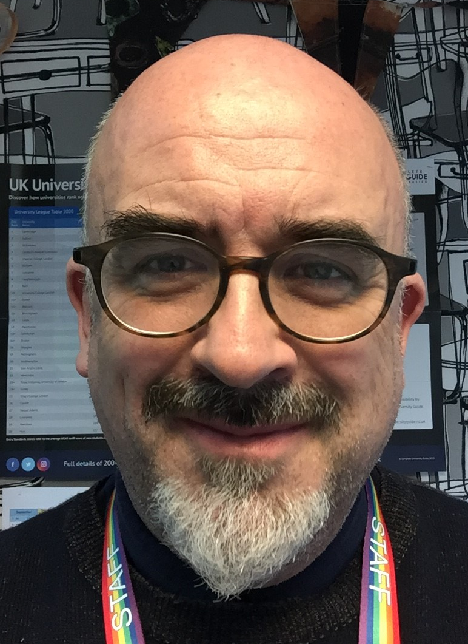


Ian McAlister
Director of Progression
Higher Education
OVERVIEW
FOR STUDENTS APPLYING FOR UNIVERSITY START IN SEPTEMBER 2027 OR LATER

Slide 7
USE YOUR TUTOR TIME & PROSTUDY & PROGRESSION SESSIONS TO FOLLOW THE
PATHWAYS FOR UNIVERSITY

Slide 8

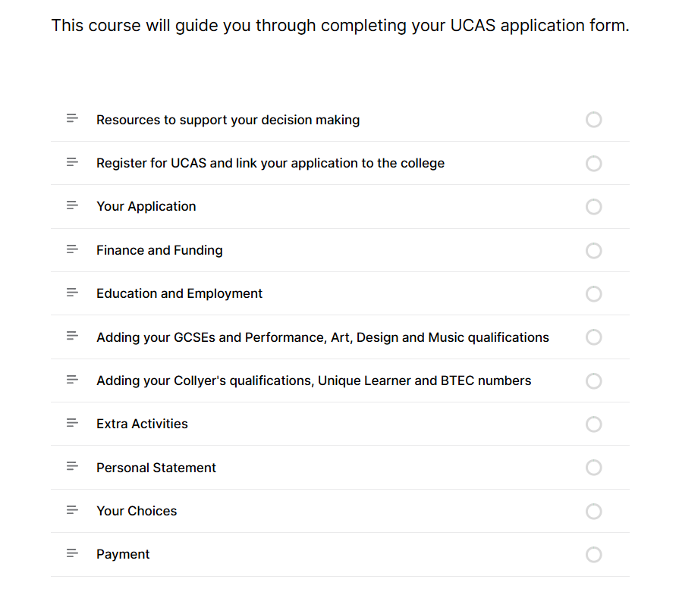
https://rise.articulate.com/share/IA-uE5xpeUk4QKagrM6wIrn68T8psl3B

Slide 9

THIS GUIDE GIVES YOU THE BASIC STEPS YOU WILL NEED TO FOLLOW WHEN COMPLETING YOUR UNIVERSITY APPLICATION
GREATER DETAIL IS FOUND WITHIN THE PROGRESSION PATHWAYS THAT YOU WILL BE FOLLOWING IN PROSTUDY BEFORE THE END OF THE SUMMER
SPECIFIC QUESTIONS CAN BE DIRECTED TO im@collyers.ac.uk)
SECTIONS INDICATED BY COLOURED CORNERS
Thinking about where you might like to study.
Additional research to help make decisions.
Who helps me with this application, at college?
Filling out your UCAS application
What will it be like at University?
How much will it cost?
Recap on what to do now

Slide 10
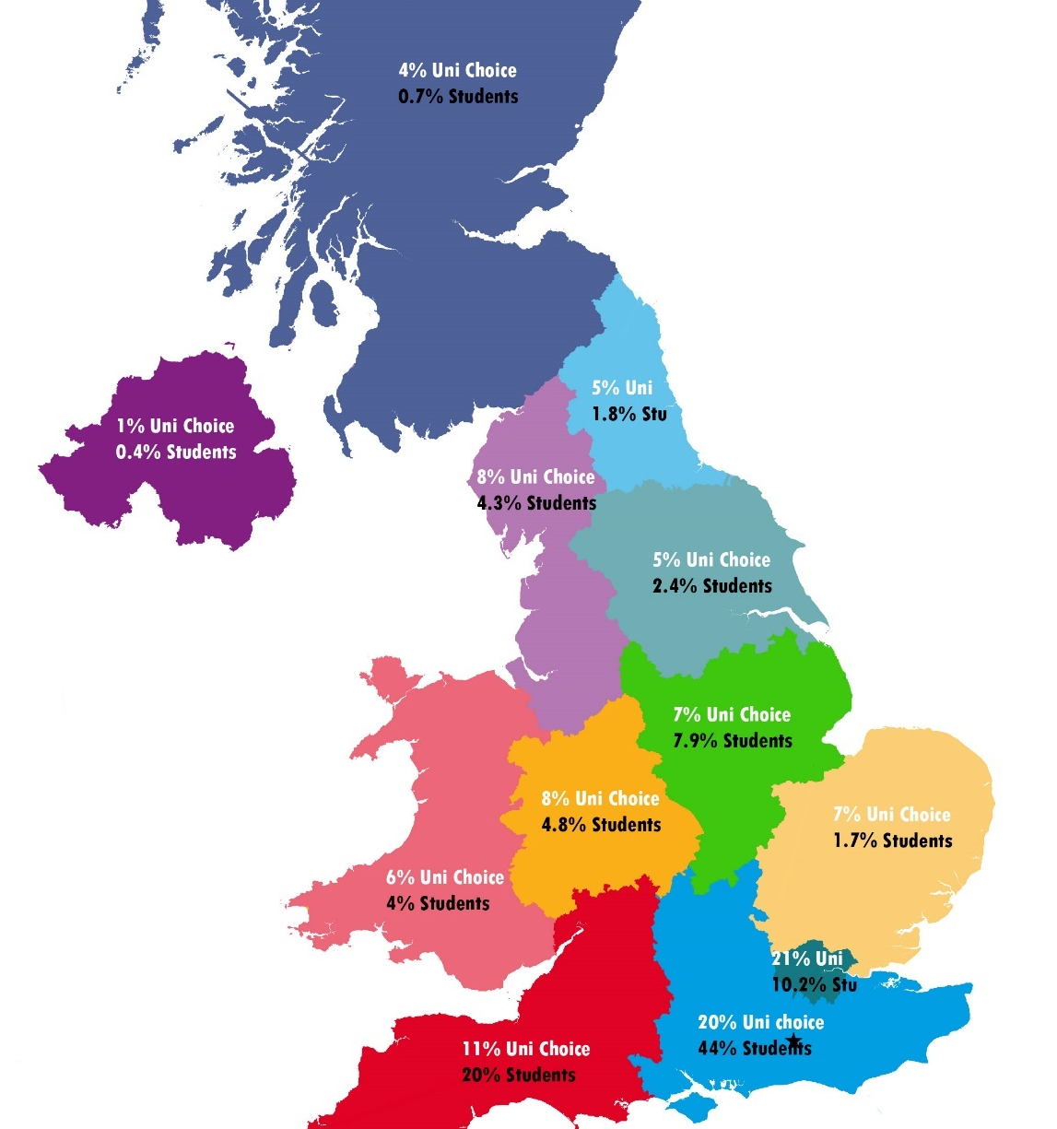
HOW DO I DECIDE WHERE TO GO?
Of our Students
study in the South
74%
Choose from……
Over 300 HE Institutions
(164 Unis)
Over 50,000 courses
Over 700,000 students each year
Traditional Courses (Maths, English, Sciences, etc)
New Courses (criminology, immersive media, etc)
Combined Studies (eg. French with History, etc)
Sandwich Courses (with year in industry or abroad)
Campus/Non Campus (live on campus? Or in the surrounding area?)
Chosen Universities
are in the South
52%

Slide 11

1
BOURNEMOUTH
BRIGHTON
BRISTOL
CHICHESTER
EAST ANGLIA
EXETER
KENT
NOTTINGHAM
PORTSMOUTH
RAVENSBOURNE
READING
SOUTHAMPTON
SURREY
SUSSEX
UCL
WARWICK
WINCHESTER
CURRENT TOP UNIVERSITY CHOICES OF
COLLYERS
STUDENTS

Slide 12
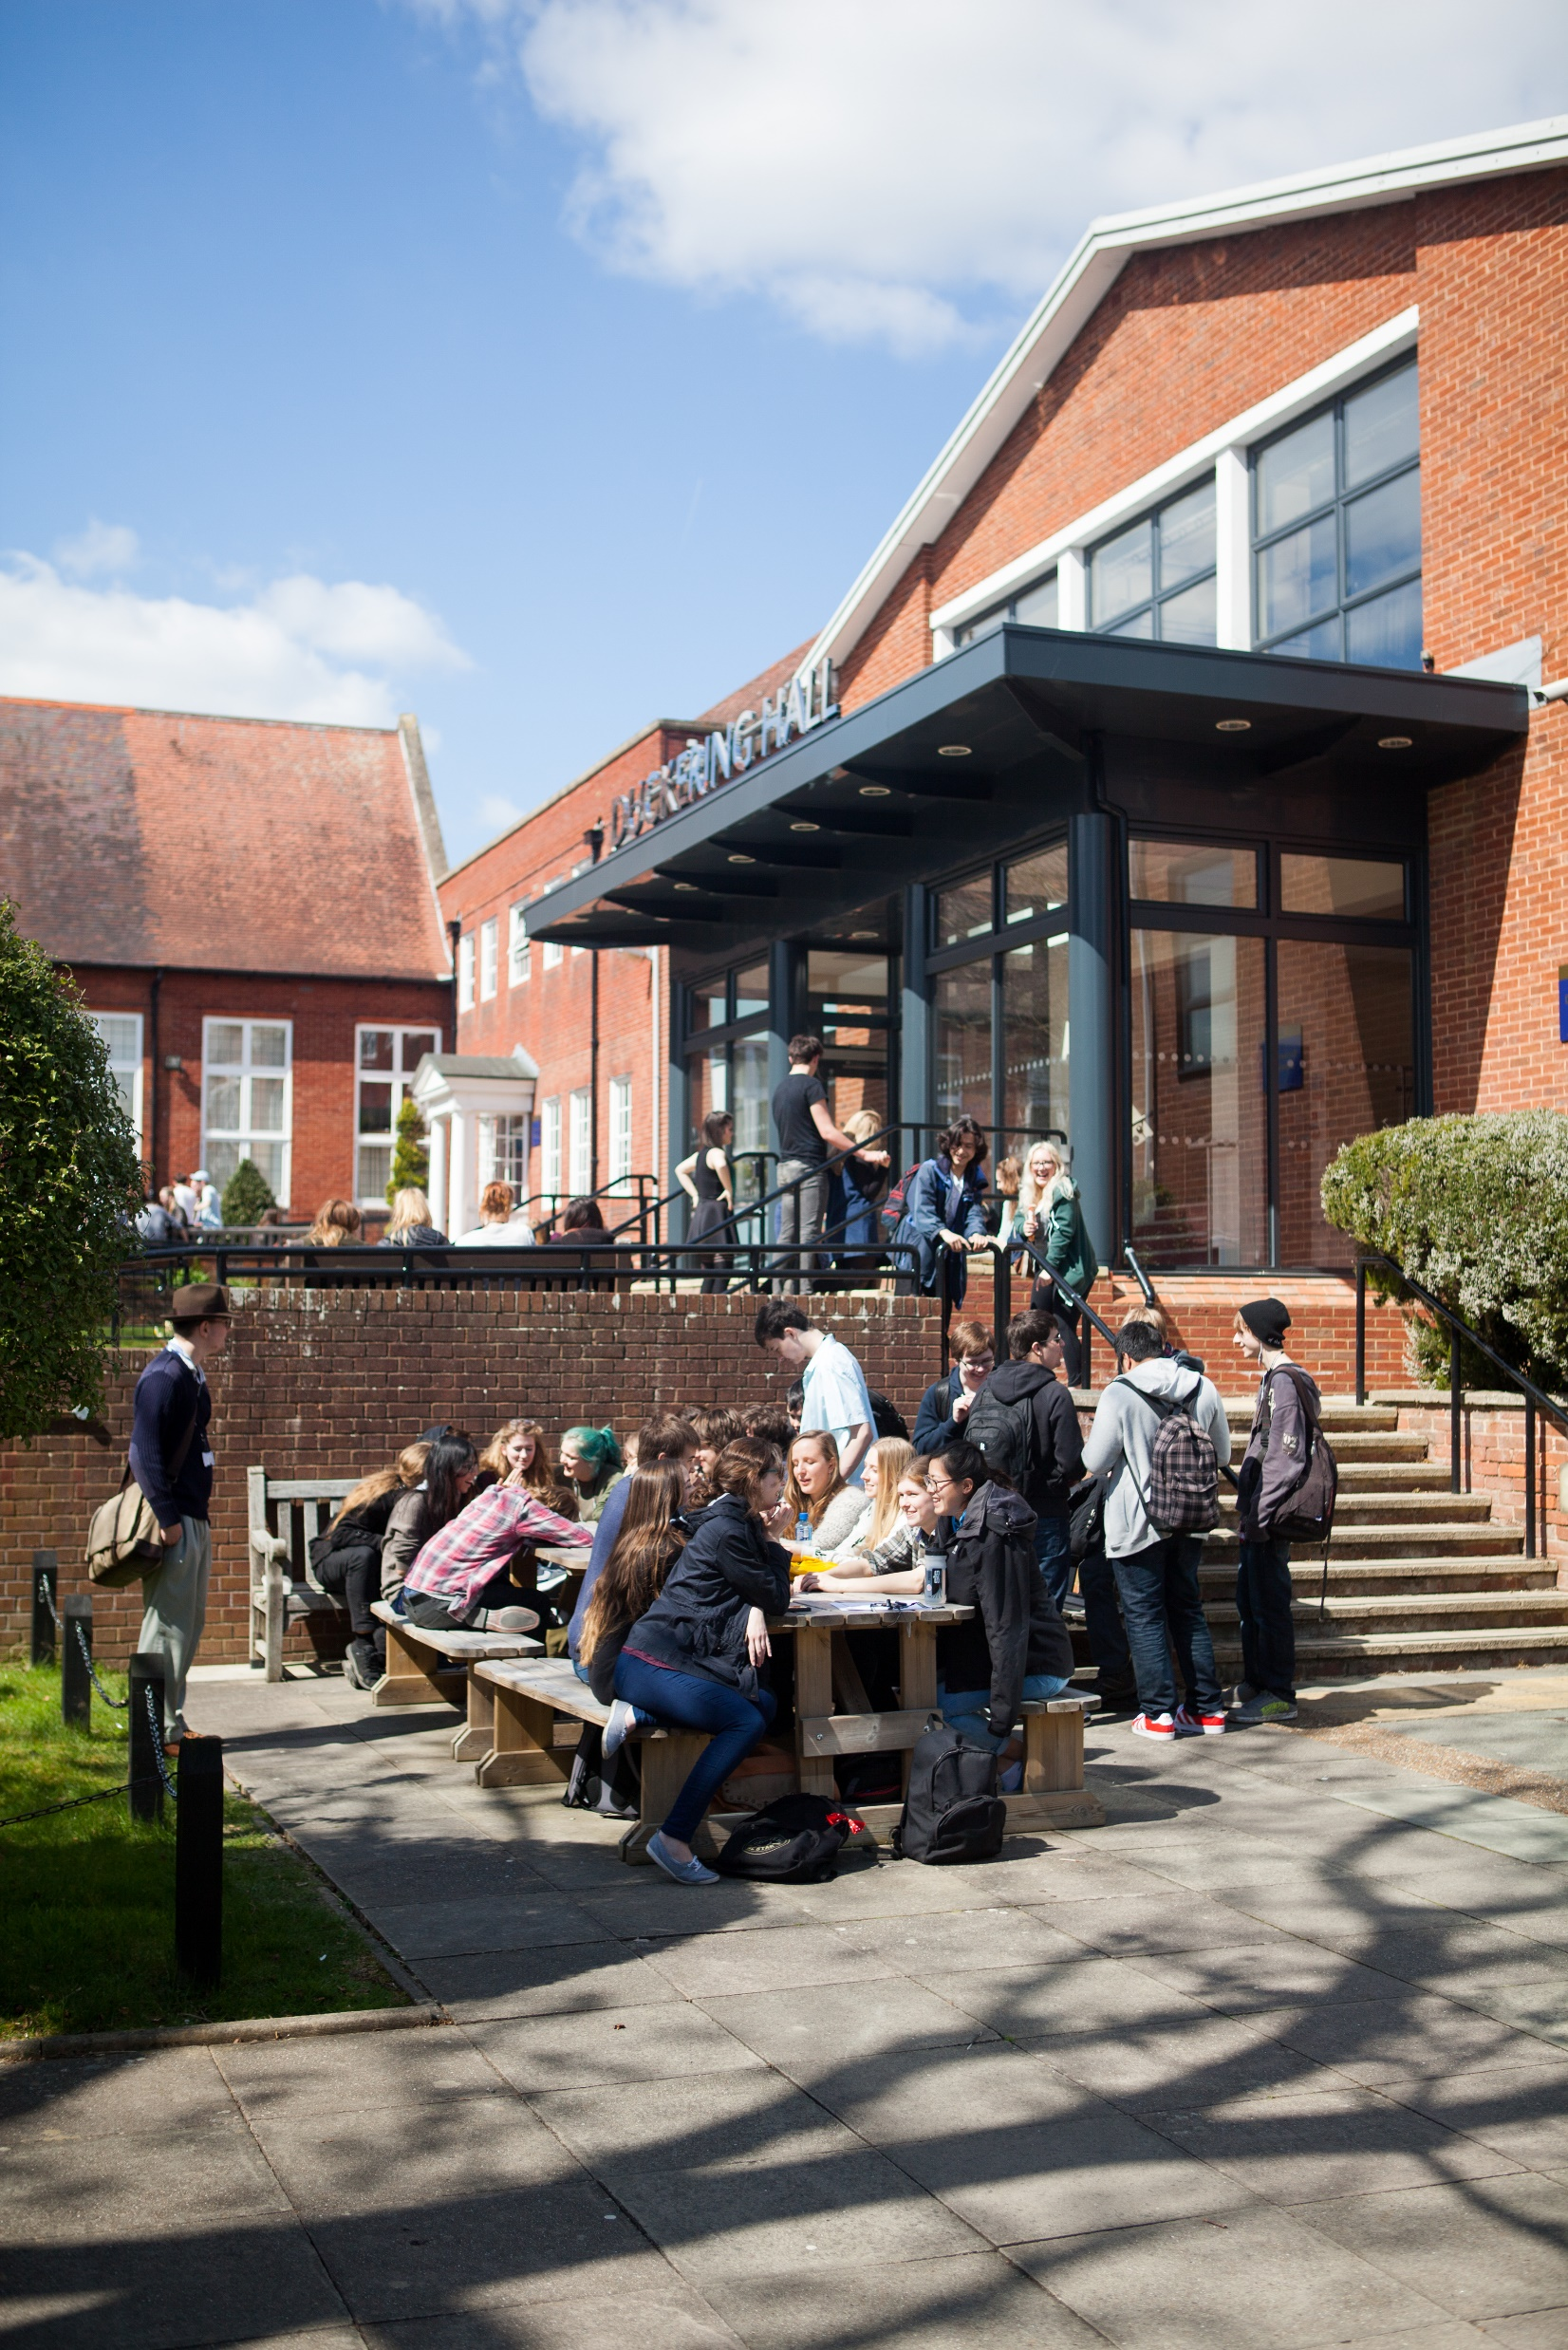
HOW DO I DECIDE WHAT TO STUDY?
Consider..
A subject you have already studied?
A subject that relates to a career?
Something completely new?
Start making lists
What do you enjoy?
What are you good at?
What do want from life?
Do you want to be close to home?

Slide 13

WE RECOMMEND
THAT YOU VISIT YOUR SHORTLISTED UNIVERSITIES - SO YOU CAN SEE THE CAMPUS & AREAS THEY ARE IN
BOOK OPEN DAYS USING THIS SITE OR BY BOOKING DIRECTLY
ON THE UNIVERSITY SITES.

Slide 14

ADDITIONAL RESEARCH TO HELP MAKE DECISIONS
CAN’T GET TO THE UNIVERSITY THEN GO THERE VIRTUALLY!
Alphabetical list of virtual tours
https://www.ucas.com/undergraduate/what-and-where-study/open-days-and-events/virtual-tours
https://www.ucas.com/ucas/events/find/scheme/virtual-and-digital?keywords=

Slide 15

USE UNIFROG TO HELP CHOOSE YOUR UNIVERSITIES
2
Start with what you want to study….
Then use UNIFROG to begin searching for what courses are available. If you have not already taken a UNIFROG personality and careers quiz then why not try this as well?

Slide 16
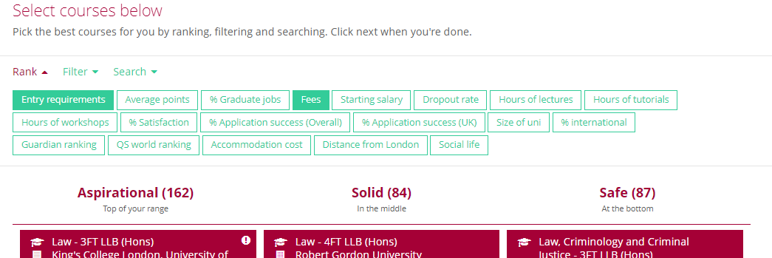
USE SMART RANKING AND FILTERS TO NARROW DOWN CHOICES
ON OR ABOVE YOUR PREDICTED GRADES
WITHIN YOUR PREDICTED GRADES
UNDER YOUR PREDICTED GRADES

Slide 17
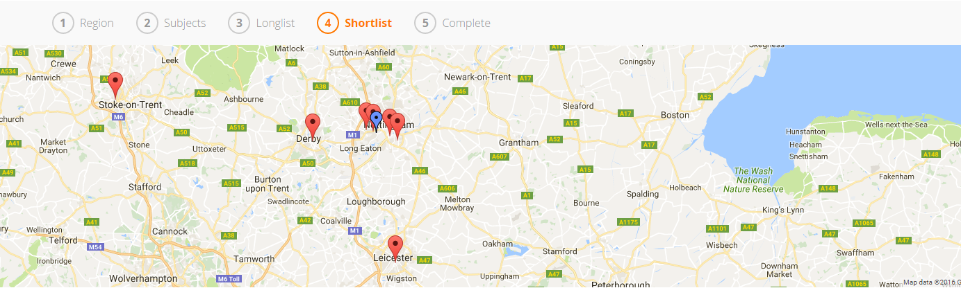
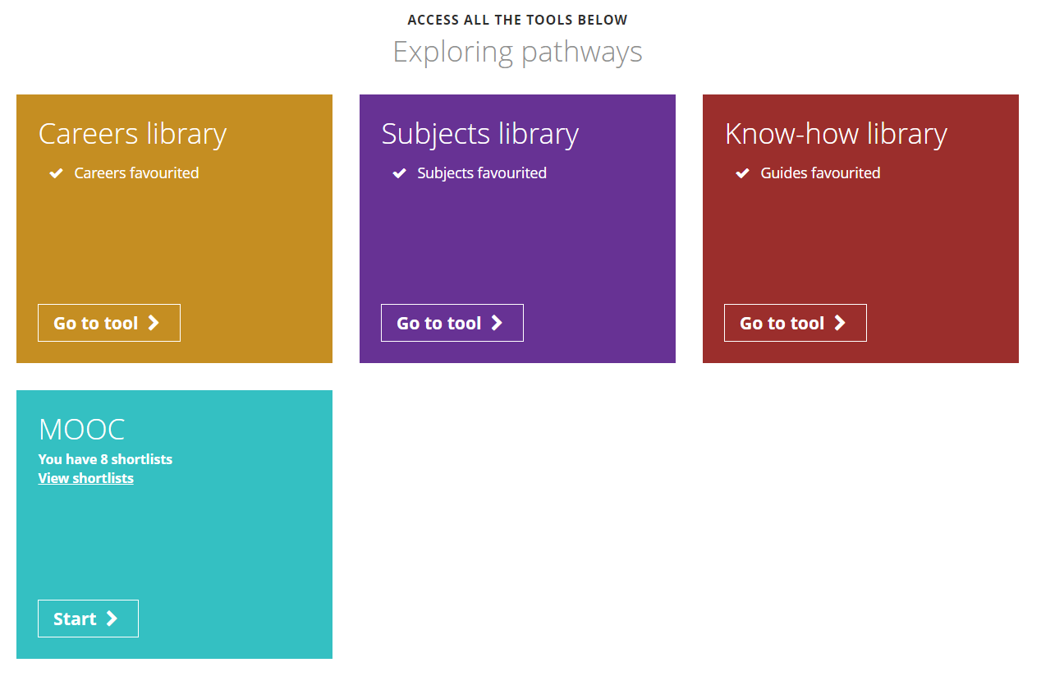
The map on each tool shows you the location of your chosen courses so you can easily compare your travelling distances.
If you’re not sure what you want to do when you leave college, there is lots of exploring for you to do on Unifrog.

Slide 18
YOU WILL ALSO NEED A PERSONAL STATEMENT

Slide 19
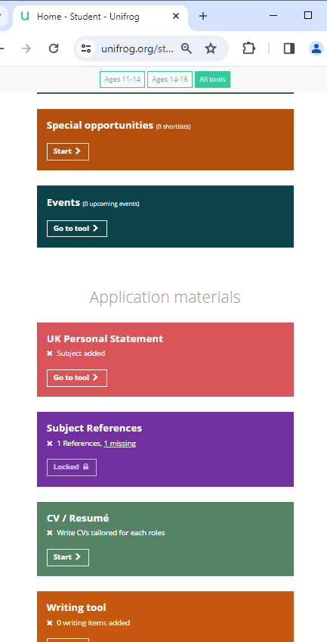
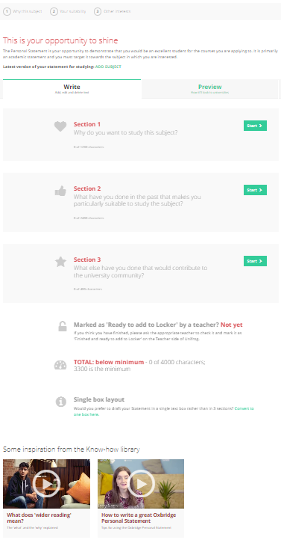
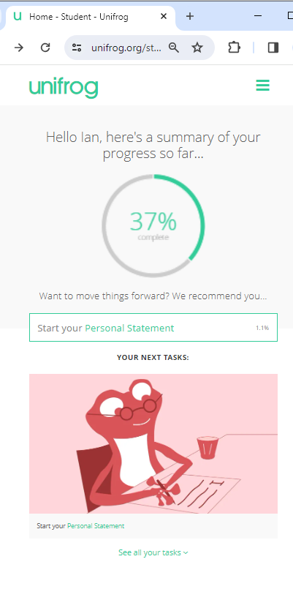
Log into the student side of Unifrog and on the student homepage….
THIS TAKES YOU TO THE THREE BOX PERSONAL STATEMENT HELPER
Choose Start your Personal Statement in tasks or find the UK Personal statement tile in application material (scroll down)

Slide 20
YOU WILL NEED TO CHOOSE BETWEEN ONE AND FIVE PLACES TO APPLY TO

Slide 21
RUSSELL GROUP UNIVERSITIES
University of Birmingham
University of Bristol
University of Cambridge*
Cardiff University
Durham University
University of Edinburgh
University of Exeter
University of Glasgow
Imperial College London
King's College London
University of Leeds
University of Liverpool
PREDICTED
A & A* GRADES
MEAN YOU CAN APPLY TO …..
London School of Economics & Political Science
University of Manchester
Newcastle University
University of Nottingham
University of Oxford*
Queen Mary University of London
Queen's University Belfast
University of Sheffield
University of Southampton
University College London
University of Warwick
University of York
* OXBRIDGE IS AN EARLY APPLICATION

Slide 22
The application process is on line through UCAS APPLY linked to the college.
We add references and predicted grades to your application form.
The process does not ‘open’ for 2026 applications until late May.
Student’s Tutors will oversee the process of compiling a reference for the student, which is built from references written by each of the student’s teachers.
Tutors will check the application, the UCAS administration team will add the reference and predicted grades - it is then sent to UCAS.
This careful support system ensures students apply for the right courses resulting in 88% of Collyers students completing their undergraduate degrees with a 1st/2.1. This makes Collyer’s consistently one of the highest ranking colleges for graduate success, when measured against all education sectors.
CURRENT UCAS DEADLINES
Students need to have applied by…
Students need to have replied by…..
2026
Apr 28 - UCAS’ search tool displays 2027 courses
May 12 - Undergraduate applications open for 2027 entry
Note* Students fill out forms after Progression Pathway begins on June 8th
Jul 09 - Conservatoire applications open for 2027 entry
Sep 01 - Completed undergraduate applications can be submitted to UCAS
SEP 14 – First draft of Personal statement due on UNIFROG (put in ‘locker’ – Ask Teacher for Feedback – select your tutor).
SEPT 21st Deadline for Oxbridge Vets Medics Conservatoires
Oct 01 - (18:00 UK time) Application deadline for conservatoire music applications (dance, drama, and musical theatre courses may have a different deadline – check conservatoires’ websites for information.)
Oct 15 - (18:00 UK time) Equal consideration date for applications to Oxbridge, and for most courses in medicine, dentistry, and veterinary medicine/science.
OCT 02 – Deadline for all remaining applications to be submitted to College for processing before UCAS deadline
2027
Jan 13 - (18:00 UK time) Equal consideration deadline – all application after this date considered as late.
2027
Feb 09 – UCAS 1st Conservatoires reply deadline (May vary)
Feb 25 - Extra opens –
May 05 -UCAS 1st Undergraduate reply deadline (May vary)
Jun 30 – all applications received after this are entered INTO clearing
Jul 01 - Last day for Extra
Jul 02- Clearing opens
Jul 14 UCAS Undergraduate reject by default applications submitted by 30 June.
Jul 19 - UCAS Conservatoires Final date for 2027 entry applications
Oct 18 - Last date to add 2027 entry Clearing choice

Slide 23
PLAN AHEAD - THINK A.B.C
A= AIM HIGH ASPIRATIONAL PLAN
B= BE REALISTIC BACK UP PLAN
C= CHANGE CLEARING PLAN

Slide 24
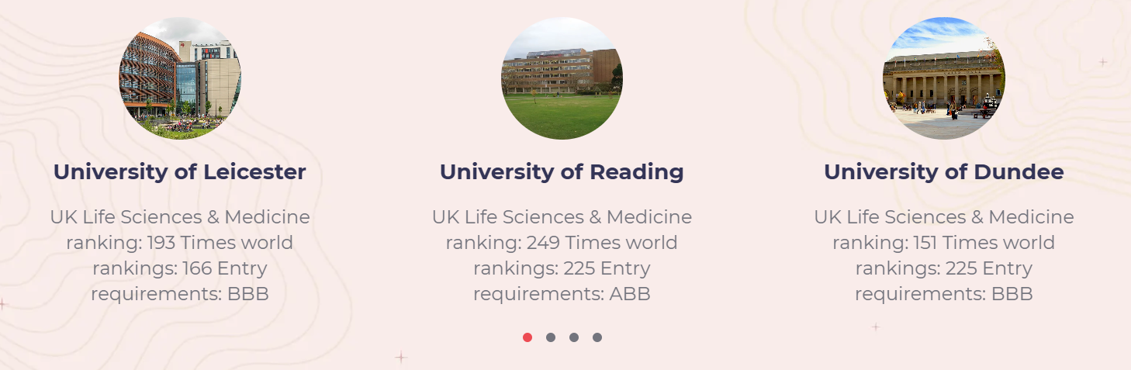
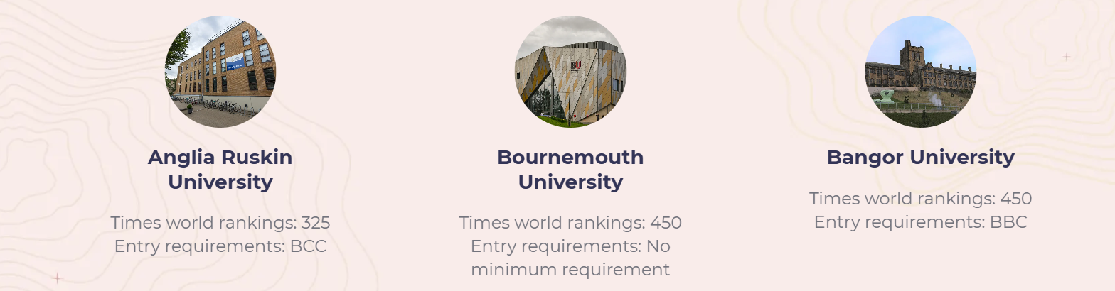
Universites will offer you places based upon your predicted grades - understand what those grades are and choose a range of courses that allow you some aspirational courses (Just above your predicted grades) some solid courses ( on your predicted grades) and some safe courses ( below your predicted grades)
ABB
BBB
BBB
Make sure you double check all information on offical uni websites as well as some websites can have incorrect information
BCC
BBC

Slide 25
COSTS = £28.95 FOR 5 COURSE CHOICES AT UP TO 5 UNIVERSITIES
DOCTORS & VETS GET 4 MEDICAL COURSES + 1 ADDITIONAL COURSE
STUDENTS THEN CHOSE 1 FIRM OFFER AND 1 INSURANCE OFFER FROM THE 5
NO OFFERS? UCAS EXTRA ALLOWS YOU TO APPLY FOR NEW COURSES 1 AT A TIME
FAILED TO MEET CONDITIONS OF OFFER AFTER RESULTS DAY?
UCAS CLEARING ALLOWS YOU TO APPLY FOR NEW COURSES 1 AT A TIME

Slide 26
STEPS INVOLVED IN PROCESSING A STUDENTS UCAS FORM
(TAKES ABOUT TWO WEEKS IF HANDED IN TO DEADLINE AND CORRECTLY FILLED OUT)
Working to college deadlines ensures forms are processed before deadlines at UCAS
STUDENT
ATTENDS TUTOR
READS EMAILS
FOLLOWS STEPS IN PROGRESSION GUIDES PROSTUDY &
WORKSHOPS
WRITES PERSONAL STATEMENT
FILLS IN FORM
TUTOR
CHECKS PERSONAL STATEMENT AND UCAS FORM APPROVES FORM
UCAS ADMIN TEAM
CHECKS FORM
ADDS REFERENCE AND PREDICTED GRADES
SENDS FORM TO UCAS OR TO DIRECTOR IF IT NEEDS ADDITIONAL
WORK BEFORE SENDING

Slide 27
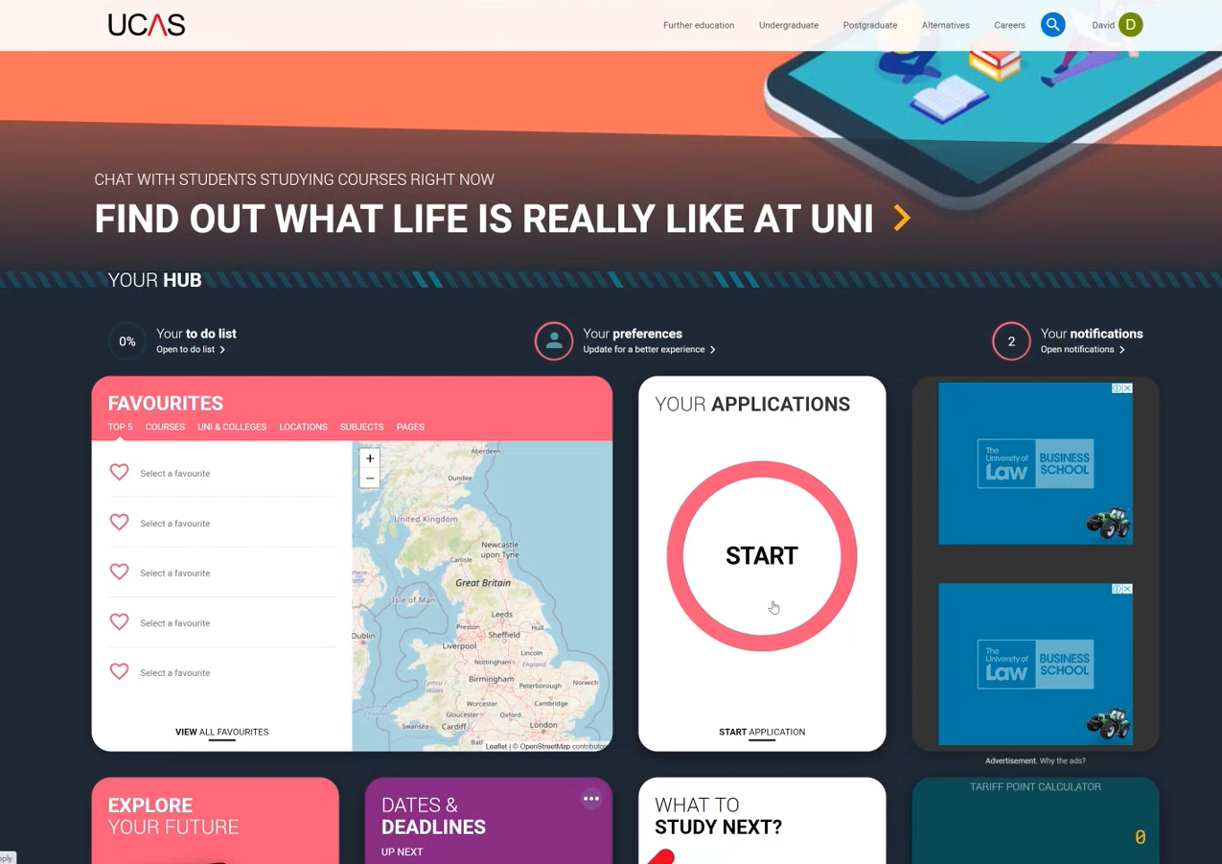
The hub presents all your options as ‘tiles’ or ‘cards’
The application process is now open for applicants wanting to attend university in September 2027
Click on the tile labelled YOUR APPLICATIONS
Notes:
The Hub displays everything you need to make the application as a set of tiles the big red arrow here is pointing at the tile that allows you to start your application process. But please be aware that it does not go fully live with 2024 information until the 16th of May. You can look at information and there may be some content that relates to 2024 but until then you will be browsing 2023 application information so please keep that in mind.

Slide 28
OTHER HELPFUL SITES WHEN MAKING YOUR CHOICES

Slide 29
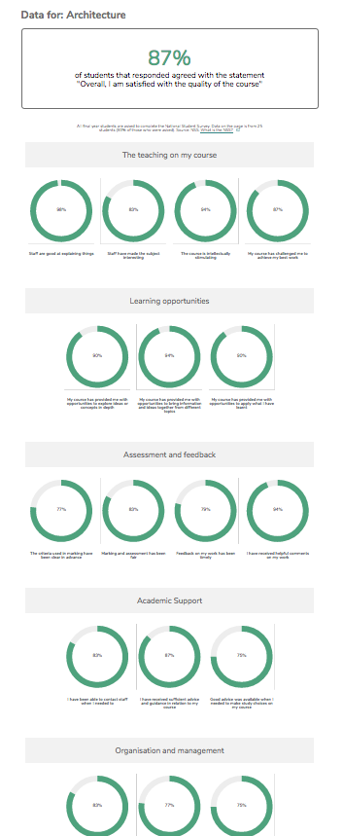
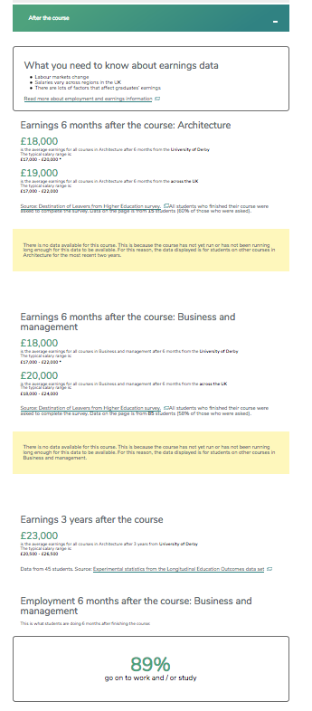

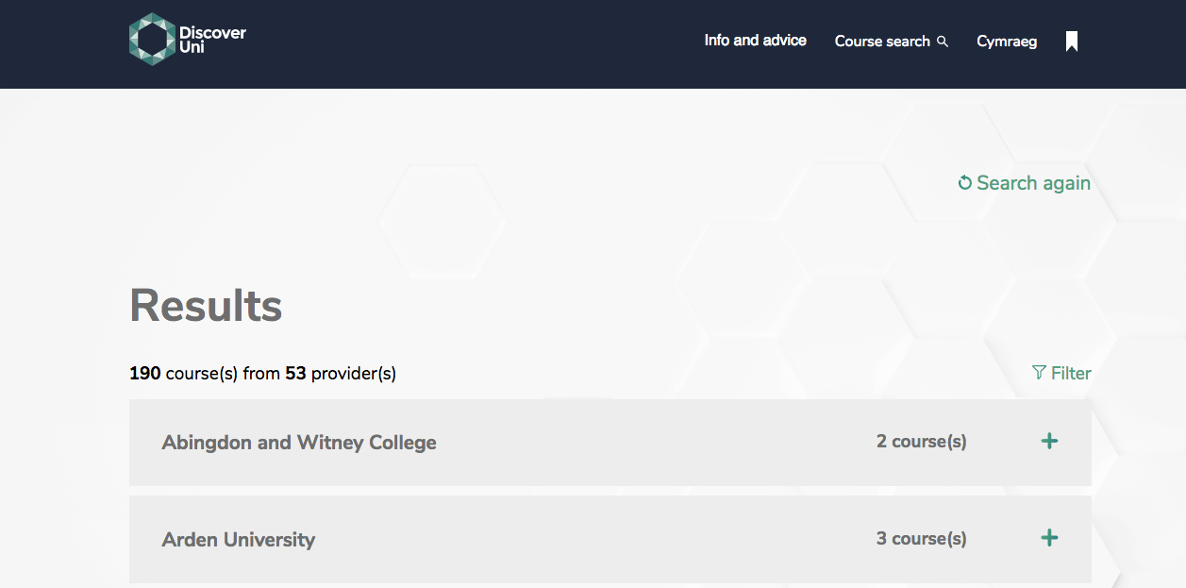
https://discoveruni.gov.uk/
RANK EVERTHING ABOUT THE UNIVERSITY USING STUDENT SURVEYS AND OFFICAL STATS – MAKE SHORT LISTS

Slide 30
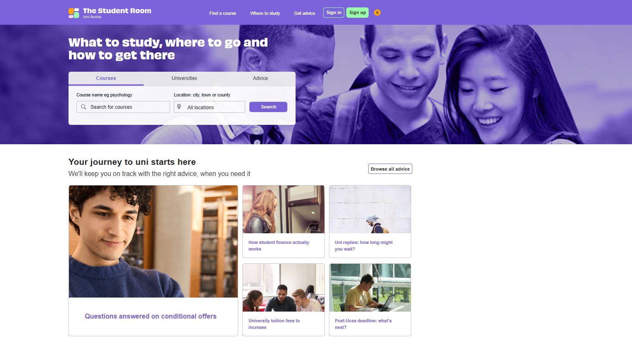
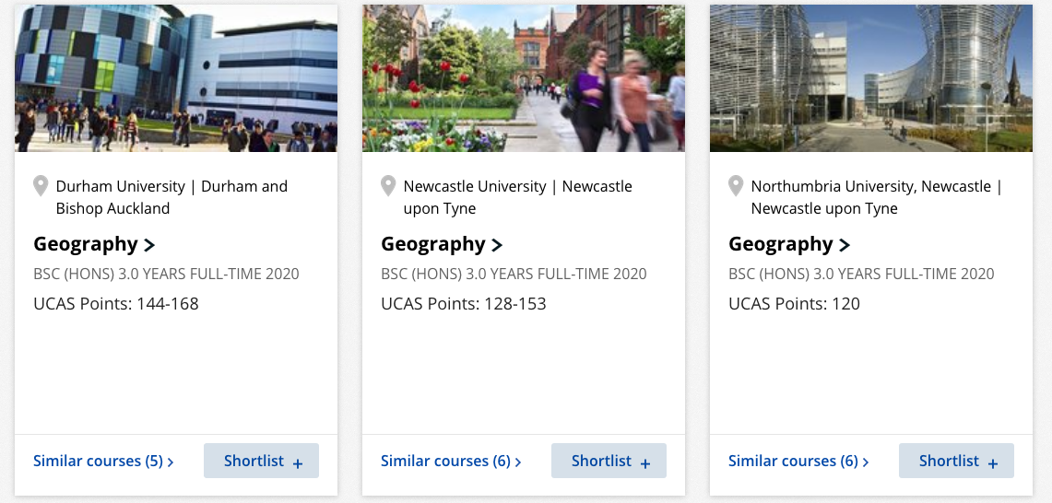
The site links to the university websites but gives you
‘at a glance’ entry requirements
https://www.theuniguide.co.uk/

Slide 31
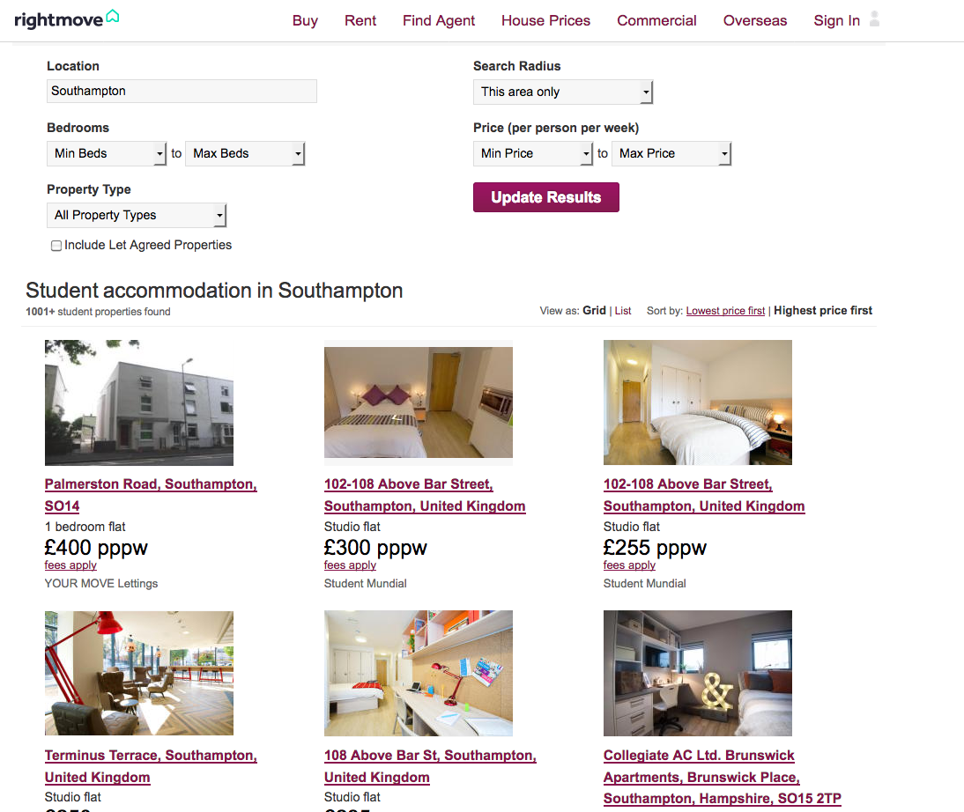
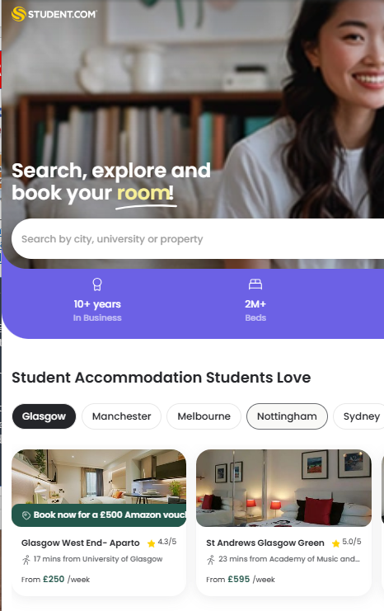
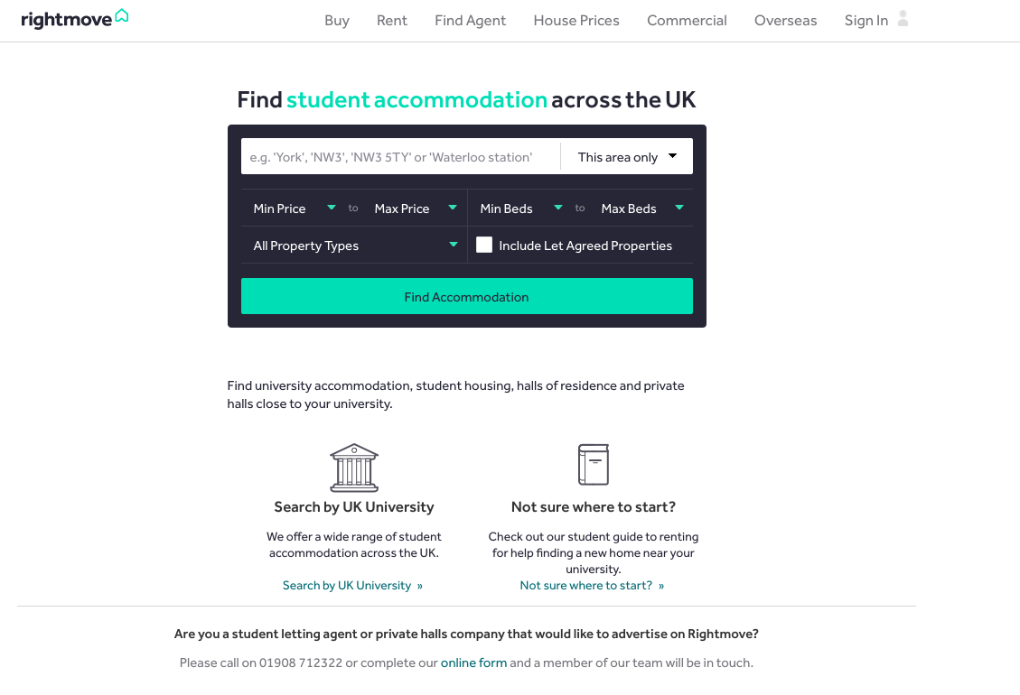
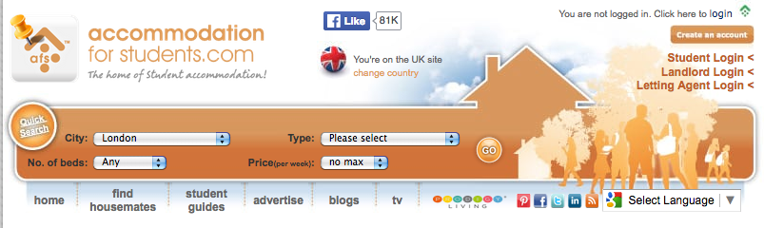
WORRIED ABOUT ACCOMODATION? THEN TRY THESE SITES
Most Universities provide halls for the first year of study, links to housing departments on all uni sites.
Independent agencies offer student accommodation. These are some of the largest and most reputable.

Slide 32
7. Recap on what to do now
RESEARCH - USE THE PROGRESSION PATHWAYS TO COMPLETE TASKS
VISIT VIRTUAL OPEN DAYS
MAKE SHORT LISTS IN UNIFROG
BEGIN DRAFTING YOUR PERSONAL STATEMENT
CONSIDER SPECIAL CONSIDERATIONS YOU MAY QUALIFY FOR
REFINE YOUR SEARCHES
VISIT AND USE THE SHAREPOINT FOR H.E AND CAREERS
TALK TO PARENTS AND FRIENDS ABOUT WHAT YOU WANT TO DO
READ THE COLLEGE INFORMATION BULLETINS AND ADVICE SENT TO YOU
PLAN AHEAD - BOOK ACTUAL OPENDAYS WHEN THEY ARE POSTED
WHAT YOU WILL HAVE COMPLETED BY THE SUMMER
1. FILLED OUT THE MAJORITY OF YOUR UCAS FORM
2. PUT THE DRAFT OF YOUR PERSONAL STATEMENT ON UNIFROG

Slide 33
‘QUICKGUIDE’
APPRENTICESHIP APPLICATION
FOLLOW THE CONTENT IN THE
APPRENTICESHIP/EMPLOYMENT SECTION OF THE PROGRESSION PATHWAYS SHAREPOINT TO ENSURE YOU APPROACH THE APPLICATION PROCESS CORRECTLY

Slide 34
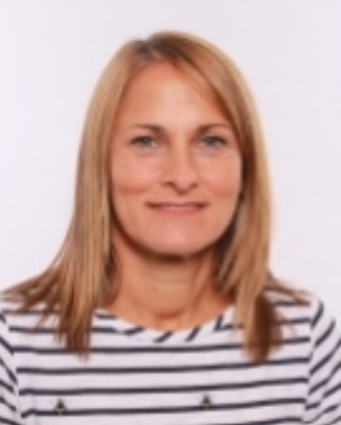
Rebecca Adams
Director of Personal Development
APPRENTICESHIP OVERVIEW
FOR STUDENTS APPLYING FOR APPRENTICESHIPS, EMPLOYMENT AND TRAINING FROM AUGUST 2027 OR LATER

Slide 35
UNDECIDED
APPRENTICESHIP & EMPLOYMENT
HIGHER EDUCATION
PROGRESSION

Slide 36
Apprenticeship & Employment Pathway
Apprenticeships
Employment
  Paid job Paid job
  Earn whilst learn Progression with experience
  (and work)
  Different levels of Additional training
  qualification may be offered

Slide 37
Apprenticeships - which levels are suitable for you?
Advanced Apprenticeship = L3 – suitable for students who have L3 qualifications in subjects unrelated to the apprenticeship programme. This is a sideways step but sometimes essential to get you onto the correct pathway.
Higher Apprenticeship = L4 & L5 - suitable for students who have L3 qualifications in subjects related to the apprenticeship programme. Competition for these apprenticeships is strong!
Degree Apprenticeship = L6 & L7 – suitable for students who have 3 A Levels/BTECs/T Level at A* to C or D*to M. Competition for these apprenticeships is intense – harder than getting into University degrees!

Slide 38
Apprenticeships – when do you apply?
Annual recruitment cycle – wave 1 launch begins in October/November and wave 2 launch is February to fit in with National Apprenticeship Week. Be ready to start the application process in September of Year 2 – the Apprenticeship/Employment Pathway tasks will prepare you for early applications in the Autumn term of Year 2.
Ongoing recruitment – some employers recruit throughout the year, when needed. They may also be happy to receive applications at any time of the year and keep your information until they have a suitable position available. The Apprenticeship/Employment Pathway tasks will prepare you for spontaneous applications as & when they are advertised.

Slide 39
Apprenticeship & Employment Pathway
Apprenticeships
Action to take now
Employment
Action to take now
Collyer’s Careers SharePoint
Apprenticeships/
Employment
Progression Pathway
Personal Statement
CV
Cover letter
LinkedIn profile
WEX
Part time job
Collyer’s Careers SharePoint
Apprenticeships/
Employment Progression
Pathway
Personal Statement
CV
Cover letter
LinkedIn profile
WEX
Part time job

Slide 40
Apprenticeship & Employment Pathway
Apprenticeships
Action to take now
Employment
Action to take now
Government Find an Apprenticeship website ***
UCAS Apprenticeship guidance
Unifrog Apprenticeship search
Apprenticeship Open Days **
Social media search
Friends & family
Harris Lord – Horsham based (very helpful!)***
Indeed
Reed
Unifrog Careers Library
Careers Fairs** (in college and in the local area)
Social media search
Friends & family

Slide 41
Have any more questions about applying for apprenticeships?
Sign up to the Apprenticeship Application Workshop
Wednesday 8th July
P006
3:10pm – 4.15pm
MyP Shop/Enrichment
DON’T MISS
OUT!!

Slide 42

‘Aspirational Apprentices’ Enrichment
Autumn Term Friday Enrichment OR
Spring Term Friday Enrichment
(students cannot take part in both terms)
2A Students only
Sign up at Enrichment selection in September
Be quick! Spaces are limited and it’s REALLY popular!
DON’T MISS
OUT!!

Slide 43
‘Aspirational Apprentices’ Enrichment
Guest speakers from apprenticeship providers
Top tips from current apprentices & employers
Support with Find an Apprenticeship registration
Build your LinkedIn profile
DON’T MISS
OUT!!

Slide 44

Need more support with your progression planning?
Careers & WEX Drop-in sessions
Tuesdays & Thursdays
1:20 – 2:05pm
Careers Office – K003

Slide 45

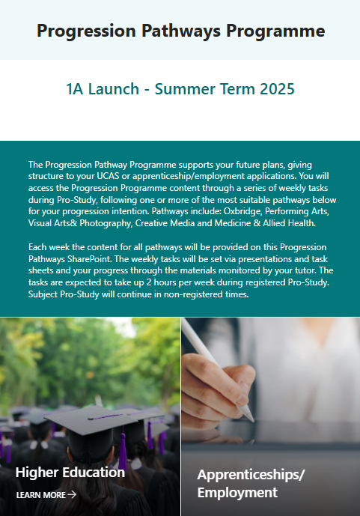
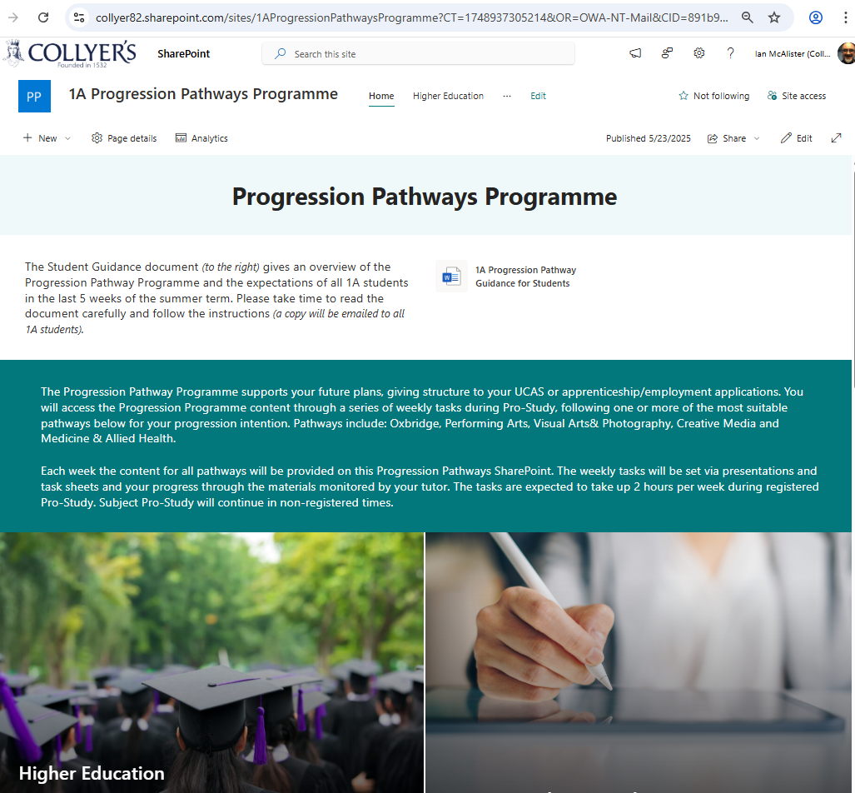

1A Launch – June 2026

